Slide 1

Lecture 14 Depth and 3D Estimation
ECE 1390/2390
Image from
https://my.clevelandclinic.org/

Slide 2
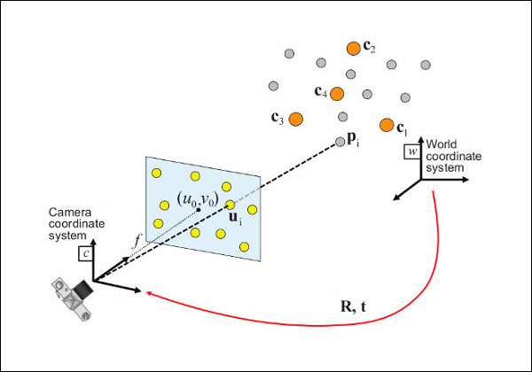
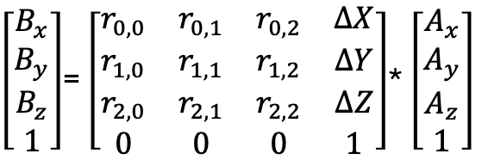


Prospective-n-Point (PnP)
$\left[\begin{matrix}B_{x} \\ B_{y} \\ B_{z} \\ 1\end{matrix}\right]$= $\left[\begin{matrix}r_{0,0} & r_{0,1} & r_{0,2} & ∆X \\ r_{1,0} & r_{1,1} & r_{1,2} & ∆Y \\ r_{2,0} & r_{2,1} & r_{2,2} & ∆Z \\ 0 & 0 & 0 & 1\end{matrix}\right]$* $\left[\begin{matrix}A_{x} \\ A_{y} \\ A_{z} \\ 1\end{matrix}\right]$
3D to 2D projection
$$\left[\begin{matrix}u_{ideal} \\ v_{ideal} \\ 1\end{matrix}\right]=\left[\begin{matrix}1 & 0 & 0 & 0 \\ 0 & 1 & 0 & 0 \\ 0 & 0 & 1 & 0\end{matrix}\right]\left[\begin{matrix}B_{x} \\ B_{y} \\ B_{z} \\ 1\end{matrix}\right]$$
Intrinsic Camera distortion (K)
$$\left[\begin{matrix}u \\ v \\ 1\end{matrix}\right]=\left[\begin{matrix}f_{x} & γ & c_{x} \\ 0 & f_{y} & c_{y} \\ 0 & 0 & 1\end{matrix}\right]\left[\begin{matrix}u_{ideal} \\ v_{ideal} \\ 1\end{matrix}\right]$$

Slide 3

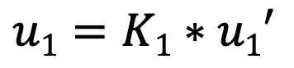
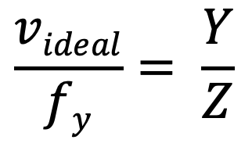
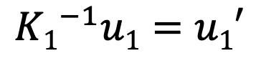
Measured position (imperfect)
Actual position is along this vector
$$u1=K1∗u1′$$
$$\left[\begin{matrix}u \\ v \\ 1\end{matrix}\right]=\left[\begin{matrix}f_{x} & γ & c_{x} \\ 0 & f_{y} & c_{y} \\ 0 & 0 & 1\end{matrix}\right]\left[\begin{matrix}u_{ideal} \\ v_{ideal} \\ 1\end{matrix}\right]$$
Point in image
Y
$${K1}^{−1}u1=u1′$$
Z
f_{y}
Camera axis
Measured position (corrected)
Camera
$$\frac{videal}{fy}= \frac{Y}{Z}$$

Slide 4

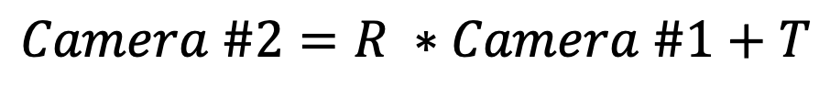

Actual position is along this vector
$$\left[\begin{matrix}u_{Camera\#1} \\ v_{Camera\#1}\end{matrix}\right]=\left[\begin{matrix}1 & 0 & 0 \\ 0 & 1 & 0\end{matrix}\right]\left[\begin{matrix}B_{x} \\ B_{y} \\ B_{z}\end{matrix}\right]$$
$$\left[\begin{matrix}u_{Camera\#2} \\ v_{Camera\#2}\end{matrix}\right]=\left[\begin{matrix}1 & 0 & 0 \\ 0 & 1 & 0\end{matrix}\right]\left(R∗\left[\begin{matrix}B_{x} \\ B_{y} \\ B_{z}\end{matrix}\right]+T\right)$$
Point in image
Point in image #2
Z
f_{y}
Camera axis
Camera
Camera
$$Camera \#2=R ∗Camera \#1+T$$

Slide 5
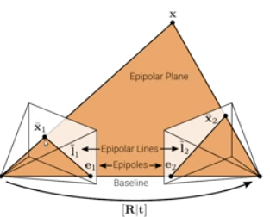
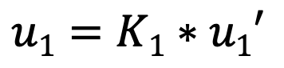
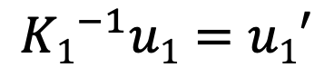

Epipolar coordinates
Epipolar plane is defined by the three points:
Camera Origin1
Camera Origin 2
3D point of interest
$$u1=K1∗u1′$$
$$\left[\begin{matrix}u \\ v \\ 1\end{matrix}\right]=\left[\begin{matrix}f_{x} & γ & c_{x} \\ 0 & f_{y} & c_{y} \\ 0 & 0 & 1\end{matrix}\right]\left[\begin{matrix}u_{ideal} \\ v_{ideal} \\ 1\end{matrix}\right]$$
$${K1}^{−1}u1=u1′$$

Slide 6
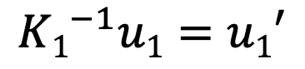
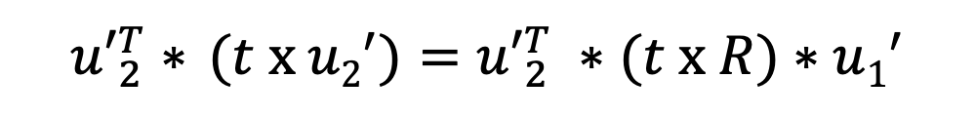

Epipolar coordinates
$${K1}^{−1}u1=u1′$$
If I know the R and T between the cameras:
$${u2}^{′}=R∗u1^{′}+t$$
Take cross product with t on both sides
$${t x u2}^{′}=(t x R)∗u1^{′}+t x t$$
0
Take dot product with u₂^{t} on both sides
$${u′}_{2}^{T}{∗ (t x u2}^{′})={u′}_{2}^{T} ∗(t x R)∗u1^{′}$$
0

Slide 7


Epipolar coordinates
$$0={u′}_{2}^{T}∗ \left(t x R\right)∗ u1^{′}$$
$$0={u′}_{2}^{T}∗E∗u1^{′}$$
$$E=t x R$$
Essential matrix

Slide 8
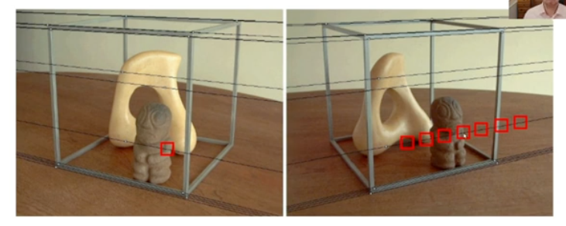
Epipolar coordinates
Projection by the Essential matrix produces a (epipolar) line
$$I2=E∗u1^{′}$$
$$I1=ET∗u2^{′}$$

Slide 9
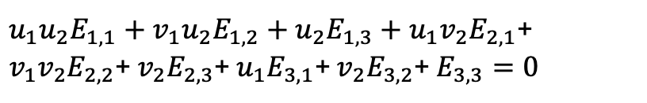
Epipolar coordinates
$$0={u′}_{2}^{T}∗E∗u1^{′}$$
Foil out matrix equation:
$u_{1}u_{2}E_{1,1}+v_{1}u_{2}E_{1,2}+u_{2}E_{1,3}+u_{1}v_{2}E_{2,1}$+ $v_{1}v_{2}E_{2,2}$+ $v_{2}E_{2,3}$+ $u_{1}E_{3,1}$+ $v_{2}E_{3,2}$+ $E_{3,3}=0$
8 unknowns (plus 1 scale)
Need 8+ corresponding points in the two images

Slide 10


Epipolar coordinates
$$E=(t x R)$$
$$tTE=tT\left(t x R\right)=0$$
t is the null projector of the essential matrix
$$SVD\left(E\right)→2 nonzero and 1 zero eigenvalue$$
t

Slide 11
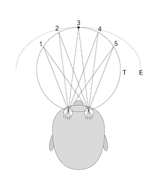
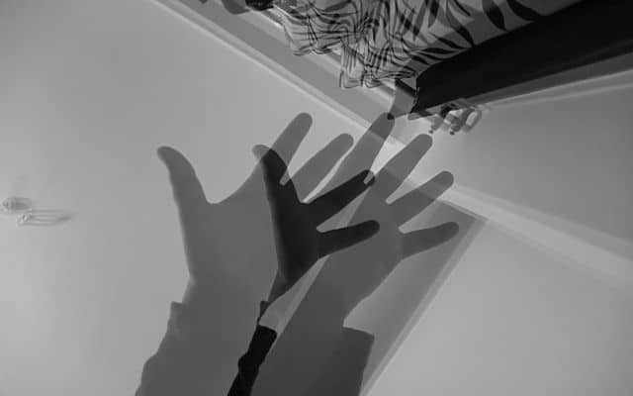
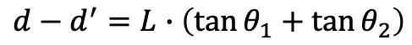
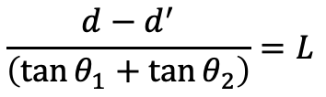
Stereo Vision
Image Displacement
← d’ →
+
+
L
𝜽₁
𝜽₂
$$d−d^{′}=L∙\left(\tan{θ_{1}}+\tan{θ_{2}}\right)$$
Camera Displacement
← d →
$$\frac{d−d^{′}}{\left(\tan{θ_{1}}+\tan{θ_{2}}\right)}=L$$

Slide 12
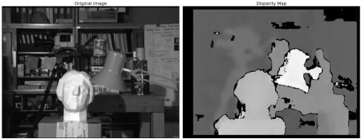
Stereo Vision
Image Displacement
← d’ →
+
+
L
𝜽₁
𝜽₂
$$d−d^{′}=L∙\left(\tan{θ_{1}}+\tan{θ_{2}}\right)$$
Camera Displacement
← d →
$$\frac{d−d^{′}}{\left(\tan{θ_{1}}+\tan{θ_{2}}\right)}=L$$

Slide 13
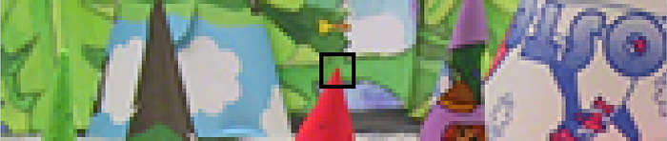
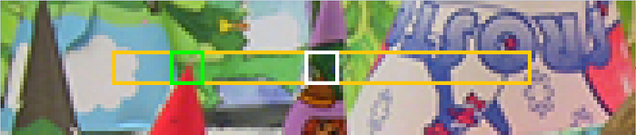
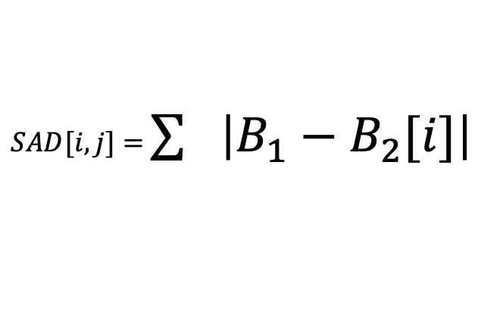
Stereo Vision
$SAD[i,j]=$ $\sum{\left|B_{1}−B_{2}[i]\right|}$
Minimum SAD → corresponding block

Slide 14
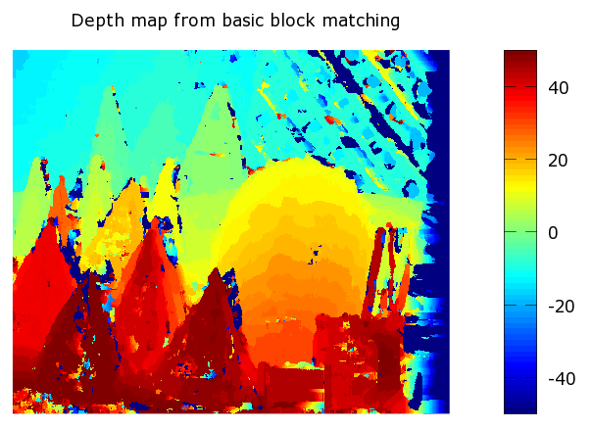
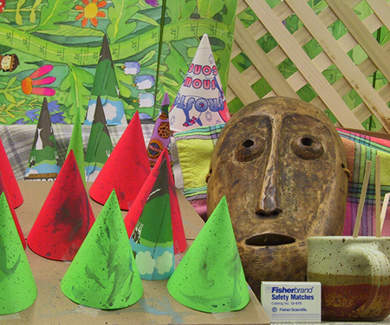
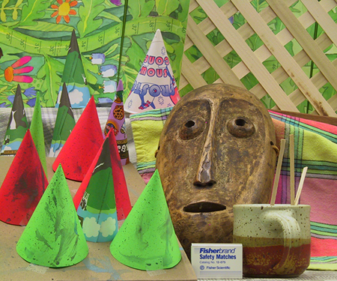

Slide 15
minDisparity: Minimum disparity value. Normally we expect 0 here but it’s sometimes required when the rectification algorithm shifts the image.
numDisparities: Max disparity value. Has to be greater than zero. Defines the disparity boundary.
blockSize: Block size for the matching blocks. Recommended is [3–11] and an odd number is recommended since odd-sized blocks have a center.
P1 & P2: Responsible for smoother images. The rule is P2>P1.
P1 – penalty for neighboring pixels
P2 – penalty for further neighbors
disp12MaxDiff: Maximum pixel difference (in pixels) for the disparity calculation.
preFilterCap: A value to be used before the filtering. Before the block matching, a derivative of the image x-axis is calculated and used to check the boundary [-prefiltercap, prefiltercap].
uniquenessRatio: After the cost function calculation, this value used to compare. Suggested value range [5–15].
speckleWindowSize: Filter to remove big values and get a smoother image. Suggested value range [50–200].
speckleRange: Used to check disparity differences with the neighbors to get a smooth image.

Slide 16
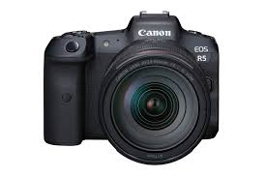
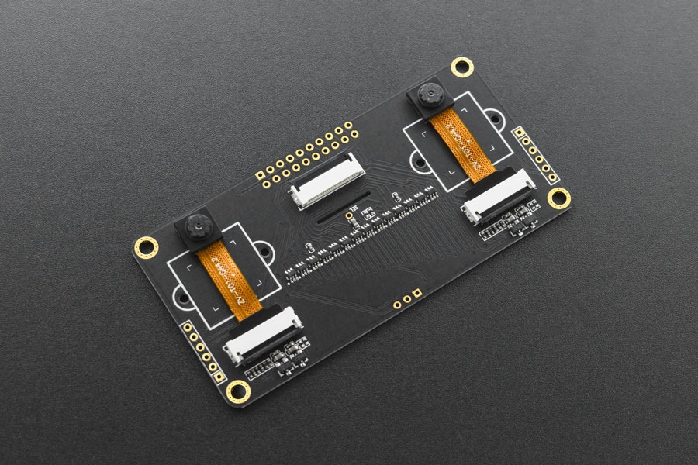
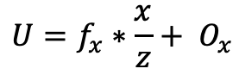
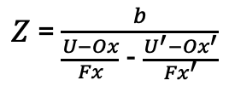
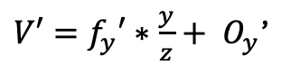
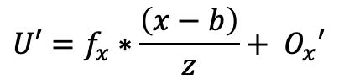
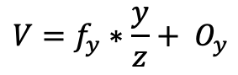
Stereo Vision
Camera 1 (left)
Camera 2 (right)
fx : focal length in x
fy : focal length in y
Ox: Origin of image in x
Oy: Origin of image in y
[U,V]: Point in image
fx' : focal length in x
fy ‘: focal length in y
Ox’: Origin of image in x
Oy’: Origin of image in y
[U’,V’]: Point in image
(0,0)
b
(b,0)
b - displacement of cameras (in x plane)
$$U=f_{x}∗\frac{x}{z}+ O_{x}$$
$$U′=f_{x}∗\frac{\left(x−b\right)}{z}+ O_{x}′$$
$Z$= $\frac{b}{\frac{U−Ox}{Fx}\text{ −} \frac{U^{′}−Ox^{′}}{Fx^{′}}}$
$$V=f_{y}∗\frac{y}{z}+ O_{y}$$
$V′=f_{y}′∗\frac{y}{z}+ O_{y}$’

Slide 17
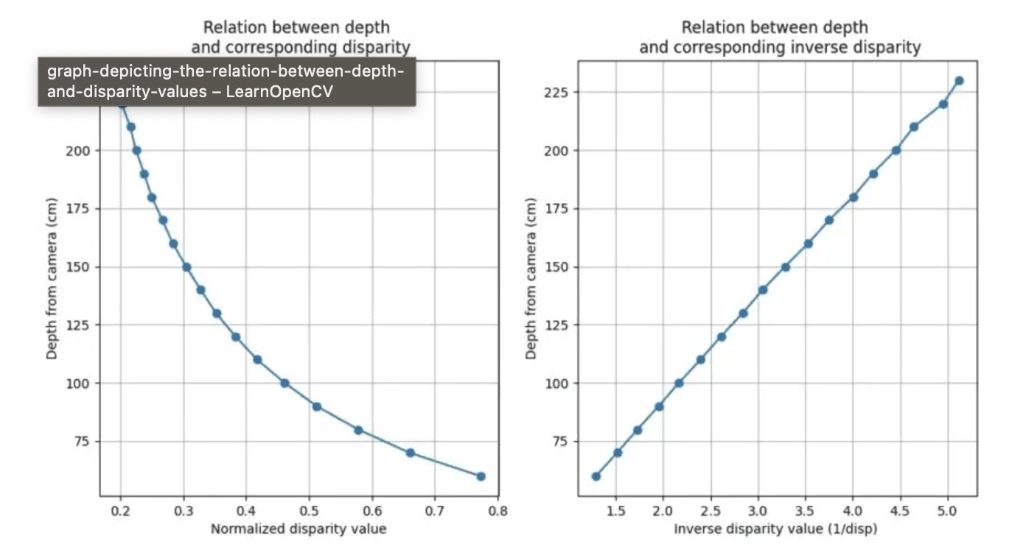
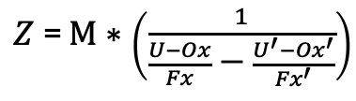
$Z$= $M∗\left(\frac{1}{\frac{U−Ox}{Fx}\text{ −} \frac{U^{′}−Ox^{′}}{Fx^{′}}}\right)$
https://learnopencv.com/depth-perception-using-stereo-camera-python-c/

Slide 18
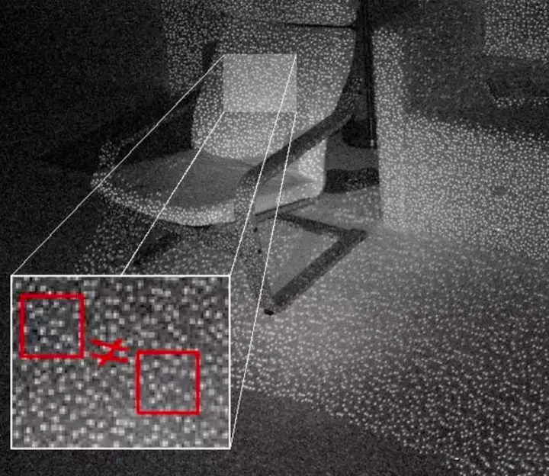
Structured Illumination
Option 1. Stereo vision
If you use two cameras, you can compute the distance/disparity between corresponding dots in the two image
Option 2. One Camera/Shift phase of structure
Changing the spatial phase of the illumination is the same as moving the source of the illumination. Thus, creating virtual offset patterns.
Option 3. Both
Here is an example (with code) for doing this yourself
https://www.instructables.com/DIY-3D-scanner-based-on-structured-light-and-stere/

Slide 19
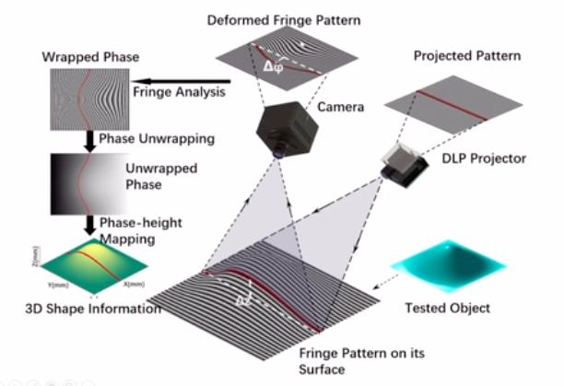
Structured Illumination

Slide 20
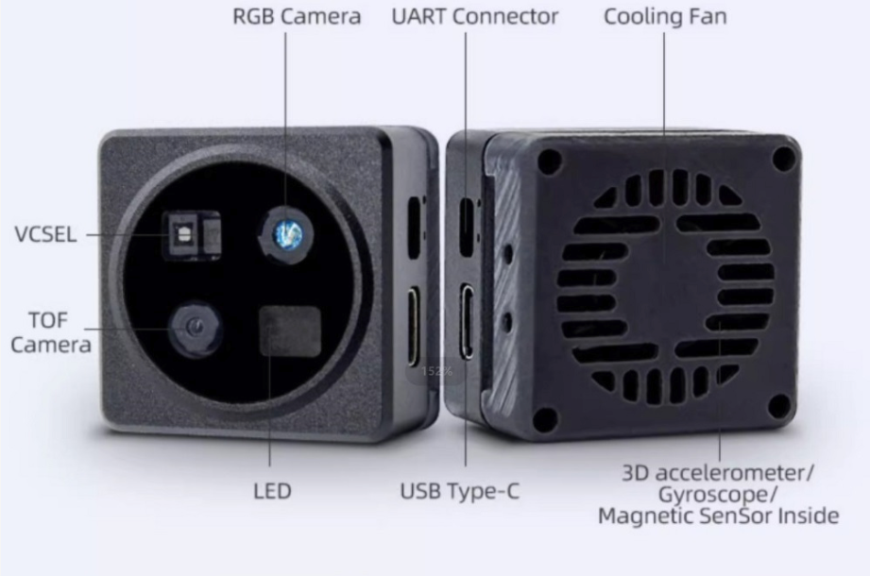
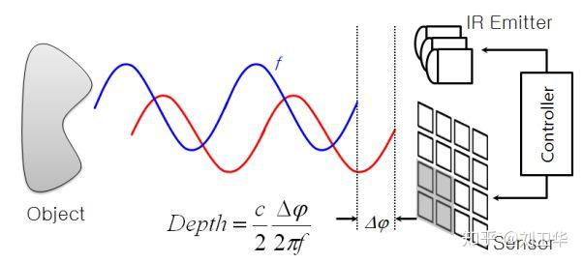
LIDAR (ToF)

Slide 21
Monocular depth estimation
MiDAS (https://github.com/isl-org/MiDaS)
Ranftl, R., Lasinger, K., Hafner, D., Schindler, K., & Koltun, V. (2020). Towards robust monocular depth estimation: Mixing datasets for zero-shot cross-dataset transfer. IEEE transactions on pattern analysis and machine intelligence, 44(3), 1623-1637.
MIT License
Fastest
Qualitative. Depth order (but not quantitative distances)
ZoeDepth (https://github.com/isl-org/ZoeDepth)
Bhat, S. F., Birkl, R., Wofk, D., Wonka, P., & Müller, M. (2023). Zoedepth: Zero-shot transfer by combining relative and metric depth. arXiv preprint arXiv:2302.12288.
MIT License
~ 4x slower than MiDAS
Depth estimation in quantitative
Marigold (https://github.com/prs-eth/Marigold)
Ke, B., Obukhov, A., Huang, S., Metzger, N., Daudt, R. C., & Schindler, K. (2024). Repurposing diffusion-based image generators for monocular depth estimation. In Proceedings of the IEEE/CVF Conference on Computer Vision and Pattern Recognition (pp. 9492-9502).
Apache License
~ 200x slower than MiDAS
PatchFusion (https://github.com/zhyever/PatchFusion)
Li, Z., Bhat, S. F., & Wonka, P. (2024). Patchfusion: An end-to-end tile-based framework for high-resolution monocular metric depth estimation. In Proceedings of the IEEE/CVF Conference on Computer Vision and Pattern Recognition (pp. 10016-10025).
MIT License
~ 400x slower than MiDAS

Slide 22
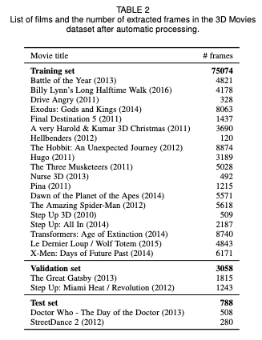
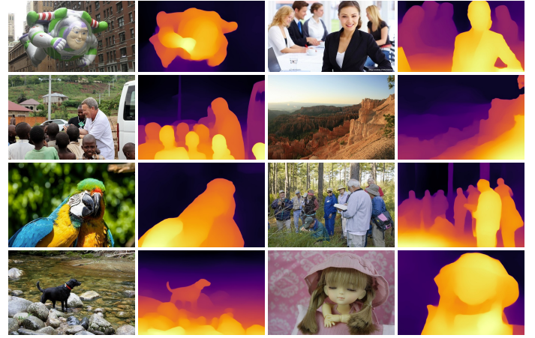
MiDAS
Deep Learning based Model
ResNET based architecture
Trained on movies available in both 3D and standard format

